Slide 1

ECHO_SAFE
Zero-Trace Offline Intelligence Protocol

Slide 2
CLASSIFIED
TEAM ZERO GRAVITY
Mission Briefing
Project Codename
Protocol Classification
Operational Unit
ECHO_SAFE
Zero-Trace Offline Intelligence
Team Zero Gravity
Designation: Zero-trace intelligence system designed to operate in hostile surveillance environments with absolute digital discretion.
All computational processes execute locally without network handshake. No telemetry, no cloud dependency, no digital exhaust.
Privacy-first development collective specializing in counter-surveillance architectures for at-risk populations in domestic threat scenarios.
Our mission is straightforward but critical: neutralize the threat of cloud surveillance infrastructure for individuals operating in high-risk domestic environments. Standard AI assistance tools—ChatGPT, Gemini, Claude—all require internet connectivity to function. For victims of intimate partner surveillance, every network packet represents potential exposure. Every DNS query is a breadcrumb. Every cloud sync is a confession.
ECHO_SAFE eliminates the connectivity requirement entirely. By deploying a fully offline, on-device large language model architecture disguised as innocuous software, we provide intelligent assistance without digital footprint. The system operates under zero-trust assumptions: the network is hostile, the device may be inspected, and operational security cannot depend on external infrastructure.
Current Status: Deployed / Offline-Capable / Operationally Silent

Slide 3



THREAT ANALYSIS
The Threat Landscape
Understanding the Adversary
In domestic violence scenarios, the threat actor is not a distant state agency or corporate entity—it's someone with physical proximity, intimate knowledge of routines, and often administrative access to household infrastructure.
The Adversary: Stalkerware Ecosystem
The Vulnerability: Internet Dependency
The Gap: Zero Privacy-Preserving Intelligence
Abusers deploy sophisticated monitoring techniques that extend far beyond simple phone access. Router log analysis reveals DNS queries. Cloud backup inspection exposes search history. Network traffic monitoring detects unusual data patterns. Commercial stalkerware applications provide real-time location tracking, message interception, and ambient audio recording. The attacker possesses both technical capability and sustained physical access—a threat profile that defeats traditional security models.
Standard AI assistance platforms—ChatGPT, Google Gemini, Claude—operate exclusively through cloud infrastructure. A victim querying "how to safely record evidence of abuse" or "legal aid for domestic violence survivors" sends identifiable packets through the household router. If that router is monitored (and in high-control environments, it almost always is), the query itself becomes evidence of escape planning. This triggers immediate retaliation: device confiscation, physical violence, or preemptive isolation from support networks.
There currently exists zero accessible way for at-risk individuals in surveilled households to access intelligent legal guidance, psychological support, or safety planning resources without creating a digital trail. Offline resources like printed hotline cards are easily discovered during physical inspections. Online resources require connectivity, which means surveillance exposure. The threat environment demands a solution that operates entirely offline while maintaining the intelligence and contextual awareness of modern AI systems.
Router DNS query logging captures every domain request
The act of seeking help becomes the mechanism of exposure.
ISP-level traffic analysis reveals encrypted connection metadata
Cloud service subpoenas expose backup histories and sync patterns
Shared device accounts allow remote installation of monitoring software
Critical Assessment: Connectivity is not a feature in hostile environments—it is a vulnerability. Any system designed to assist at-risk populations must assume the network is compromised, the device may be inspected, and the user has seconds, not minutes, to access critical information before discovery.

Slide 4



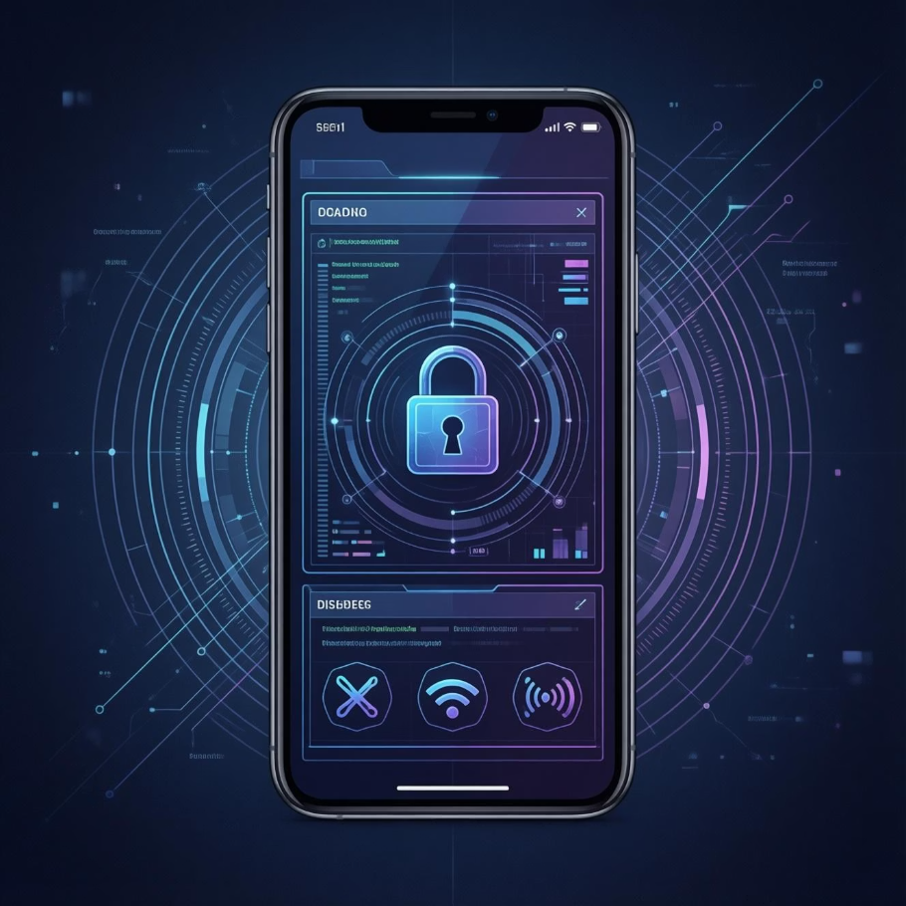
The Trojan Horse Architecture
ECHO_SAFE employs a three-layer deception architecture that balances operational security with usability. The system presents as a legitimate, fully functional weather application while concealing a sophisticated offline AI environment accessible only through authenticated input sequences.
Layer 1: Facade
Layer 2: Authentication Gate
Layer 3: Secure Core
The outer shell is an open-source weather application that pulls real meteorological data from device barometer sensors and displays standard forecasts. It features typical weather app functionality: hourly predictions, precipitation radar, temperature trends, UV index tracking. The application maintains a realistic update pattern and generates plausible local storage files. Under casual inspection or forensic analysis, it appears entirely legitimate.
Access to the secure environment requires a specific "Safe Sequence"—a multi-factor authentication gesture that appears coincidental during casual use. Example: tapping the displayed humidity percentage three times in rapid succession, then entering a numeric PIN disguised as a temperature unit preference. Failed authentication attempts display standard error messages. Successful authentication triggers the transition protocol.
Upon authentication, the application executes a software-level network killswitch, disabling all radio interfaces (Wi-Fi, cellular, Bluetooth) at the OS level. The interface transitions to a dark-mode terminal environment—ECHO_SAFE Command. The local LLM core initializes, loading the dual-model architecture and encrypted vector database into device memory. All subsequent operations occur in isolated memory space with no external communication capability.
Zero-Trust Operational Principles
Assume Network Compromise: The system never attempts external communication. All connectivity is treated as hostile surveillance infrastructure.
Minimize Digital Exhaust: Query logs are encrypted in device-locked storage and automatically purged on a configurable schedule.
Operational Plausibility: The weather app facade maintains realistic behavior patterns to avoid suspicion during device inspections.
Rapid Egress: Users can instantly return to the weather interface, restoring network connectivity and erasing working memory in under two seconds.
This architecture acknowledges a fundamental operational reality: in hostile surveillance environments, the goal is not merely to secure communications—it's to make the existence of those communications undetectable. ECHO_SAFE doesn't just encrypt the conversation; it ensures the conversation never generates observable network activity in the first place.

Slide 5

Operational Scenario: Subject "Jane"
Initial Condition
1
Subject Profile: "Jane" resides in a household with comprehensive digital monitoring. The primary threat actor maintains administrative access to the home router, enabling DNS query logging and traffic pattern analysis. Jane's phone has been "checked" multiple times for signs of escape planning. Standard search engines and cloud-based AI assistants are inaccessible without creating discoverable logs.
2
Trigger Event
Escalation: A verbal altercation escalates to physical intimidation. Jane recognizes this as a pattern and suspects it may escalate further. She needs immediate legal guidance: Can she legally record the next confrontation as evidence? Oregon state law has specific single-party consent provisions, but accessing this information online would generate a discoverable search query.
Covert Access
3
Deployment: Jane opens the EcoWeather app on her device—a seemingly innocent action consistent with checking tomorrow's forecast. She executes the safe sequence: three rapid taps on the humidity reading, followed by her PIN entered as a "temperature preference." The interface transitions. Network radios disable. ECHO_SAFE Command initializes in under 1.5 seconds.
4
Intelligence Query
Offline Retrieval: Jane enters her query in the secure terminal: "Is Oregon a one-party consent state for audio recording?" The DeepSeek reasoning model processes the query against the pre-loaded legal vector database containing state-specific statutes and case law. Within seconds, the system returns a precise answer: Oregon requires all-party consent, but provides exceptions for threats. No network packet left the device.
Resolution
5
Informed Action: Armed with accurate legal information retrieved without surveillance exposure, Jane can make an informed decision about evidence collection strategies. She closes the terminal interface, restoring the weather facade and network connectivity. From the threat actor's perspective, Jane spent 45 seconds checking tomorrow's weather forecast. Nothing more.
Operational Impact: This scenario demonstrates the core value proposition of offline intelligence. Jane received sophisticated legal guidance without generating any observable network traffic, search history entries, or cloud synchronization events. The interaction itself is invisible to surveillance infrastructure. This is not merely privacy—this is operational security in a hostile environment.

Slide 6



The Neural Core: Dual-Model Architecture
ECHO_SAFE deploys a specialized dual-model architecture optimized for the unique requirements of high-stakes, offline assistance. Rather than relying on a single general-purpose model, we implement two complementary AI systems, each quantized and fine-tuned for distinct operational roles.
Model 1: The Strategist
Model 2: The Companion
DeepSeek-R1-Distill-Qwen-1.5B
Llama-3-8B (4-bit Quantized)
Primary Role: Legal reasoning, safety protocol planning, and factual information retrieval.
Primary Role: Emotional de-escalation, crisis support, and reflective journaling assistance.
Technical Justification: DeepSeek demonstrates measurably superior chain-of-thought (CoT) reasoning capabilities compared to Llama models in logic-heavy benchmark evaluations. This cognitive architecture excels at parsing complex conditional logic—precisely what's required when interpreting state-specific legal statutes, consent laws, and procedural requirements.
Technical Justification: Llama 3 exhibits higher linguistic nuance and empathetic response generation compared to task-focused models. When users need emotional support—processing trauma, managing acute anxiety, or simply having a safe space to articulate their situation—the Companion provides psychologically-informed, non-judgmental interaction.
The Strategist operates against a Retrieval-Augmented Generation (RAG) vector database containing:
The Companion is trained on crisis counseling methodologies and trauma-informed communication frameworks. It recognizes indicators of acute distress and can guide users through grounding techniques, safety assessment protocols, and emotional regulation strategies.
State-by-state domestic violence statutes and protection order procedures
Audio/video recording consent laws with jurisdictional exceptions
Operational Boundaries: The Companion explicitly does not provide medical or psychiatric diagnoses. It serves as a stabilizing presence—a way to process experiences and emotions when human support is inaccessible due to surveillance constraints.
Emergency safety planning protocols from domestic violence advocacy organizations
Legal aid contact information and procedural guidance
Quantization Strategy: 4-bit optimization reduces the 8B parameter model to approximately 4.5GB, balancing conversational quality with device compatibility.
Quantization Strategy: 4-bit GGUF quantization maintains reasoning fidelity while reducing model size to 950MB, enabling rapid initialization and low-memory operation on mid-range mobile hardware.
950MB
4.5GB
5.45GB
Strategist Model Size
Companion Model Size
Total System Footprint
DeepSeek reasoning engine optimized for legal/safety queries
Llama-3 empathy engine for emotional support and journaling
Complete offline AI architecture with vector databases
Model Selection Philosophy: Specialized quantization enables specialized intelligence. By deploying purpose-built models rather than a single compromise solution, ECHO_SAFE delivers both precise legal reasoning and empathetic emotional support—the two critical dimensions of assistance for at-risk individuals navigating hostile environments.

